Slide 1

SAP BTP ABAP on Cloud / RAP Training
DAY-6
Anubhav Oberoy
www.AnubhavTrainings.com
Follow excellence with sheer passion

Slide 2


DISCLAIMER
The training content and delivery of this presentation is confidential, and cannot be recorded, or copied and distributed to any third party, without the written consent of Anubhav Trainings

Slide 3

01
Analytics Query
02
SQL Script
03
AMDP
04
Table functions
Notes:
https://pixabay.com/photos/san-francisco-transamerica-pyramid-1633203/

Slide 4





































My manager wants to know total sales in a dashboard by
Total sales by customer
Total sales by product
Total sales by country

Slide 5
























Slide 6

































Slide 7















Slide 8
SQL Scripting
SQL Script is a programming language used inside databases, which is an advance version of plain SQL. It is the last option to improve performance of our applications and achieve code to data paradigm by code-push-down.
Why SQL Script
In the past we used to Fetch the data in ABAP, Loop over the data, Process the data and then write data back to database. We want to fully leverage the computational powers of SAP HANA, hence using SQL script we can achieve it. All our data intensive logic which we write using ABAP can now be pushed down to HANA DB using SQL Script.
https://help.sap.com/docs/SAP_HANA_PLATFORM?locale=en-US&task=use_task
SQL Script is not case-sensitive and every line ends with semi-colon (;)
We can use the code constructs like IF, ELSE, LOOP, FOR, WHILE, RAISE
When we create variables, they are assigned with null value
The = is comparison operator and := is the assignment operator. We can assign the value to variable using the var = val but when we use the variable in the code, we use value of (:) operator to use a variable.
When we assign the a query to a variable, the variable will allocate memory automatically
www.anubhavtrainings.com

Slide 9
AMDP – ABAP managed Data procedure
Sometimes, the CDS performance is not suitable for our use case and we need more complex technique to process our data deep into database to get best performance using code-to-data paradigm
We want to use database specific features
CDS views have limitations
CDS views cannot be debugged
Overcome the disadvantages of CDS where we need to branch output of one Queries to another
We cannot write imperative logic using CDS – IF, ELSE, LOOP, WHITE, EXCEPTION etc.
CDS also does a strict type check while writing joins and associations
An AMDP is:
A static function in ABAP class marked with marker interface IF_AMDP_MARKER_HDB
The function can only have Import and Export parameters and all parameters must be passed by value
We cannot use complex data types (deep)
Any DB table which we plan to use with AMDP should be added to using clause
When we run the AMDP, A procedure gets created inside the DB
All the code will be written in SQL scripting programming language which will be pushed into the database
Since we directly execute AMDP in DB, there is no automatic client handling
www.anubhavtrainings.com

Slide 10



What is AMDP?
AMDP stands for ABAP Managed Data Procedure, it is one the best way to integrate the SQL Script code in SAP ABAP system.
An AMDP is a ABAP class which contains SQL Script code
It allows to write, test, debug, manage SQL Script code direct via ADT along with ABAP layer
You don’t need to login to HANA DB with HANA Studio
An AMDP is managed in ABAP layer hence it is transported to Q and P via ABAP transport
Debugging of SQL Script is also done in ABAP layer
Its top-down approach to push down logic to DB level
AMDP
mutation
IF_AMDP_MARKER_HDB
ABAP class
8
www.anubhavtrainings.com

Slide 11
Technicality
You can only create an AMDP if your ABAP system is running on top of HANA Database
It’s a method in the mutated ABAP class. The class can contain multiple AMDP functions
You can also have normal ABAP functions in same class as well
But the merging of ABAP code with SQL Script code is not allowed.
You cannot call any ABAP statements like calling FM, printing data, calling another class etc.
We can do design time syntax check on SQL script code and debug also
The only tool used to make AMDP is ADT (not SAPGUI)
The function must have the importing and exporting params only, returning is not allowed
All the parameters must be passed by value only
We cannot use nested tables, structures as data types of AMDP signature
Its static function of the class which can be called by classname=>function_name
AMDP function will follow a special syntax to declare
Any DB table which we want to use inside AMDP must be added as using clause in function impl.
AMDP is transported to Q and P using ABAP transport
Only SQL script language is supported
When we create AMDP nothing happens in HANA, when we call AMDP first time, an AMDP a procedure gets created inside HANA DB
The AMDP creates the procedure in ABAP schema (SAPHANADB) so we can only use those tables
9
www.anubhavtrainings.com

Slide 12
CDS Table function
Bridge the gap between CDS and AMDP, A CDS table function
Defines the skeleton of the data which we want from DB
When it executes, it actually calls SQL Script code
It creates a FUNCTION database unlike AMDP creates a PROCEDURE in database
The CDS table function, can later be used to build view on view or can be used in OTHER CDS views also as JOIN/Agg
Plain CDS functions:
https://help.sap.com/doc/abapdocu_752_index_htm/7.52/en-US/abencds_f1_builtin_functions.htm
www.anubhavtrainings.com

Slide 13
CDS Table function
A cds entity representing the return table type of the data from SQL Script (Skeleton of data)
There will be a class where we write the implementing logic in SQL script language
CDS view cannot compare heterogeneous data type. E.g. RAW16 = CHAR32
but000
Crm_partner
9
www.anubhavtrainings.com

Slide 14
CDS Scalar Function
A scalar UDF in hana which returns exactly one value.
CDS entity
Myfunc() as result
Scalar Function Definition
Class
Function code()
coda
Scalar function implementation Reference
8
www.anubhavtrainings.com

Slide 15




Challenges in ABAP development
UI
Common needs
Create application logic
Insert, update, delete, validate, select data
Perform validations
Check customizing
Handle locks
Create A/c documents
Manage Documents
Application Code
I, U, D, S, V
Search Documents
Validate before save
Alex, ABAP Developer,
SAP FICO
UI
Challenges
Thinks differently
Adapt application code
High maintenance
No standardization
Different coding practices
Lack of standard
Create Sales Orders
Manage Sales Orders
Application Code
I, U, D, S, V
Search/Filter Sales Order
Compute Sales total
Stella, ABAP Developer,
SAP SD
www.anubhavtrainings.com

Slide 16
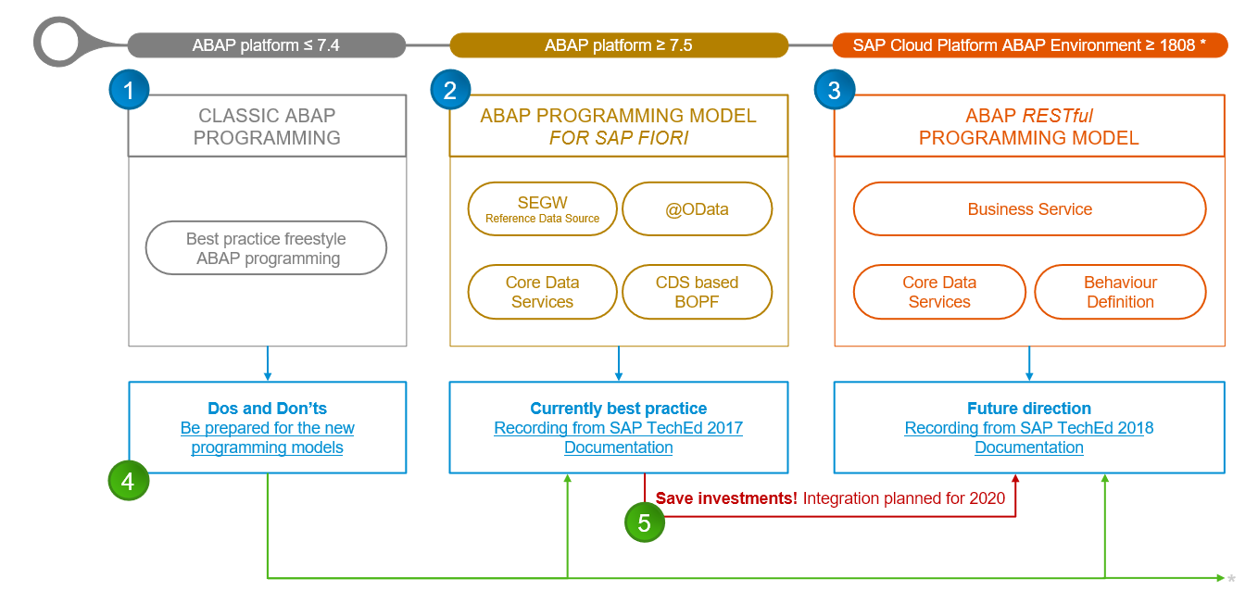
Evolution of ABAP Programming Model
www.anubhavtrainings.com

Slide 17
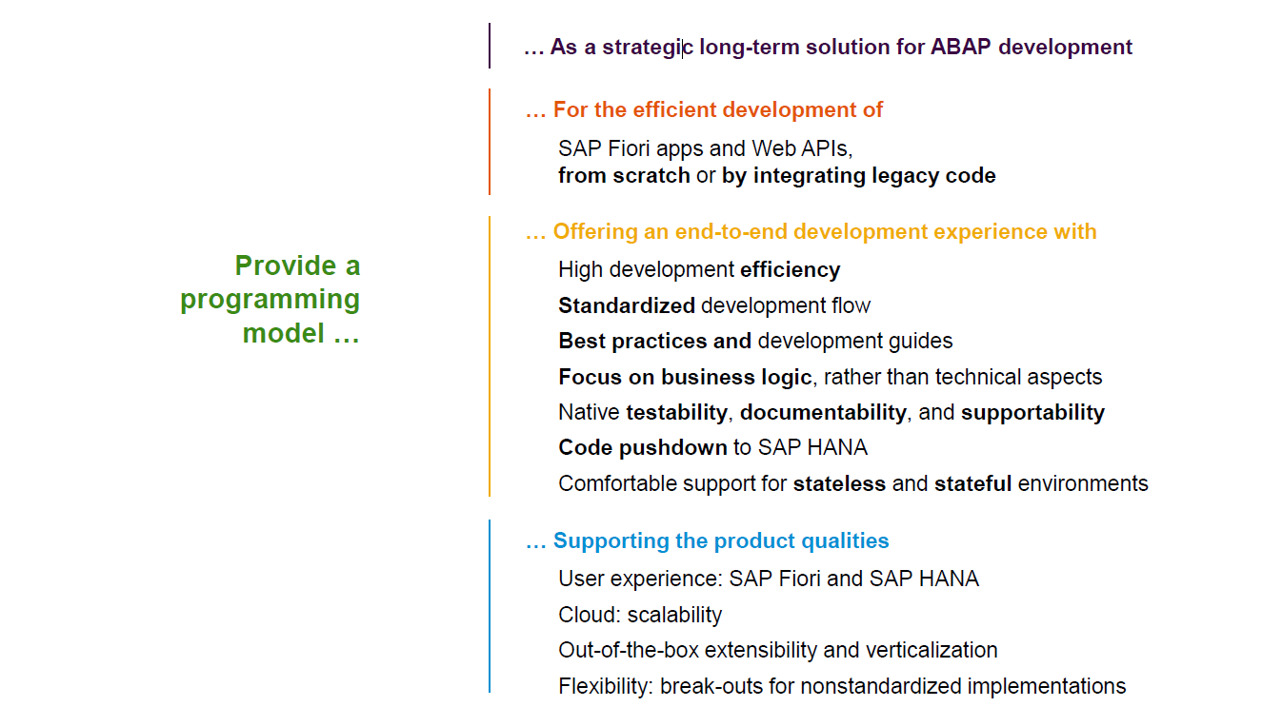
Restful ABAP Programming
www.anubhavtrainings.com

Slide 18
Restful ABAP Programming
The ABAP RAP (Restful Application Programming) Model defines the architecture for efficient application development for HANA optimized ABAP applications. It supports development of
Greenfield applications – A completely new application from scratch
Brownfield applications – A new/extension of application using OLD code
It is based on proven technologies and frameworks such as CDS entities to define semantically rich data model and service model infrastructure for creating and binding OData services for different use cases e.g. Fiori App, WebAPI, InA
www.anubhavtrainings.com

Slide 19
Components in RAP app – Technical Level
CDS entities – To develop our RAP BO (Business Object)
Business Object here is a TREE data structure which is composed of multiple nodes (parent, child), The tree starts from a root node.
Once the business object is ready, we define the behavior of the business object like can this object be created, updated, deleted. Business object is a static structure (like a class) and the records of actual data is the instance of BO (object of a class).
Finally we can create service definition and service binding
UI layer to consume the service to build application.
www.anubhavtrainings.com

Slide 20
Development Approach
Application UI (Fiori Apps)
Transactional | Analytical | Factsheet
Analytical Tools
Excel | SAC | Other..
Third Party
Your own ABAP code
Service layer (expose data over HTTP/HTTPS protocol) – OData Services (V2, V4)
SEGW, SADL, @OData, Serv. Definition and Binding
API Layer
Business logic, Data validations, Lock Unlock, Sync. Points, Branches, Manipulation logic, data flow logic, processing logic - RICEF
Customizing layer (SPRO, SM30)
Database Layer – (function modules and classes to interact with database)
LUW, Update FM, BAPIs – SELECT INSERT MODIFY UPDATE DELETE, EQ, DQ
SE11 – Data Dictionary – Tables, Views, Data Elements, Domains, LO, MC…
www.anubhavtrainings.com

Slide 21


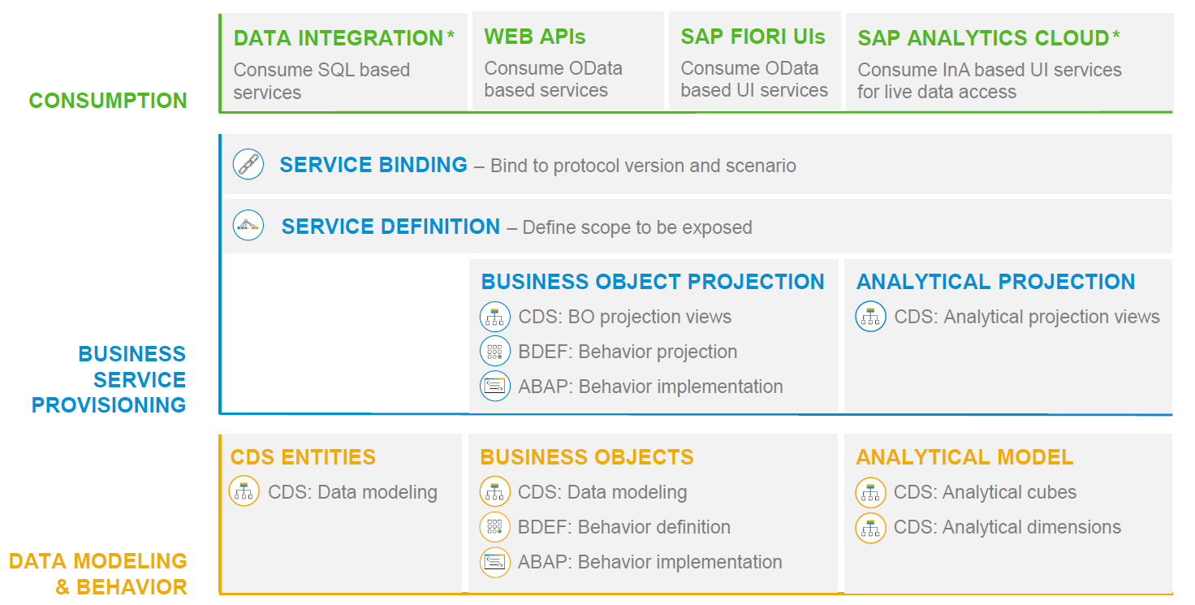
RAP – The Big picture
www.anubhavtrainings.com

Slide 22
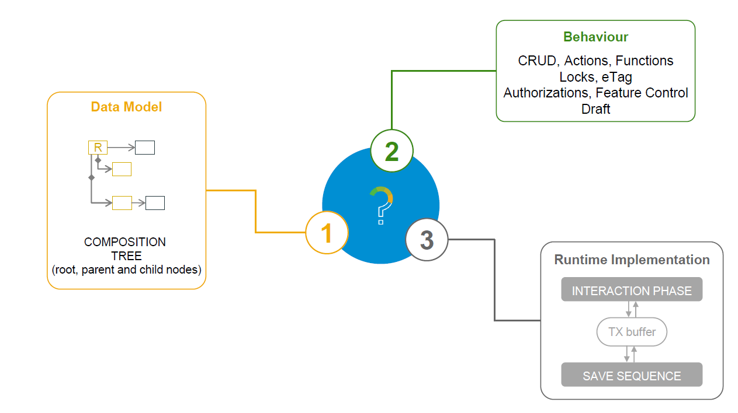
What is a Business Object
www.anubhavtrainings.com

Slide 23
Types of Implementation (Scenario)
Brownfield Implementation
Is used when we want to create a transactional application which can insert, update, delete data from the system by writing your own logic
You already have Business logic with you and you want to use that business logic to perform transactional capability
You are own your own to manage your implementation.
02. Managed Scenario
Greenfield Implementation
Is used when we want to create a transactional application which can insert, update, delete data from the system by using the framework provided implementation
You do not have Business logic with you and you want system to create business logic for you automatically.
01. Un-Managed Scenario
www.anubhavtrainings.com

Slide 24
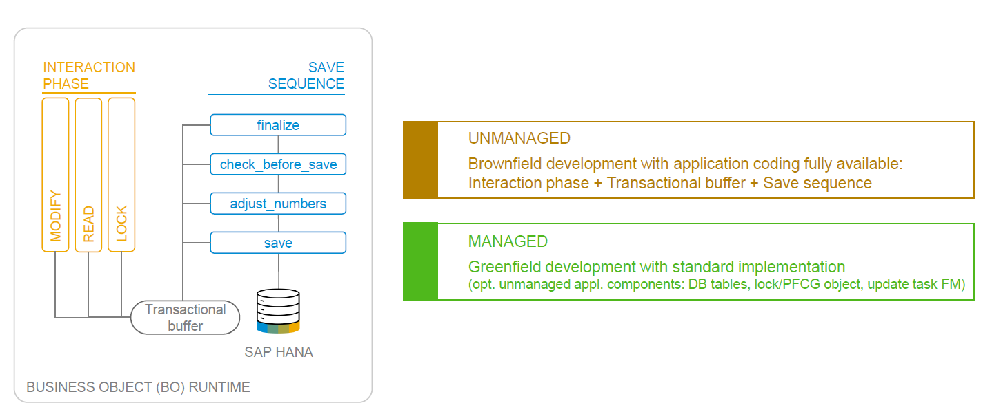
BO Runtime Implementation Types
www.anubhavtrainings.com

Slide 25

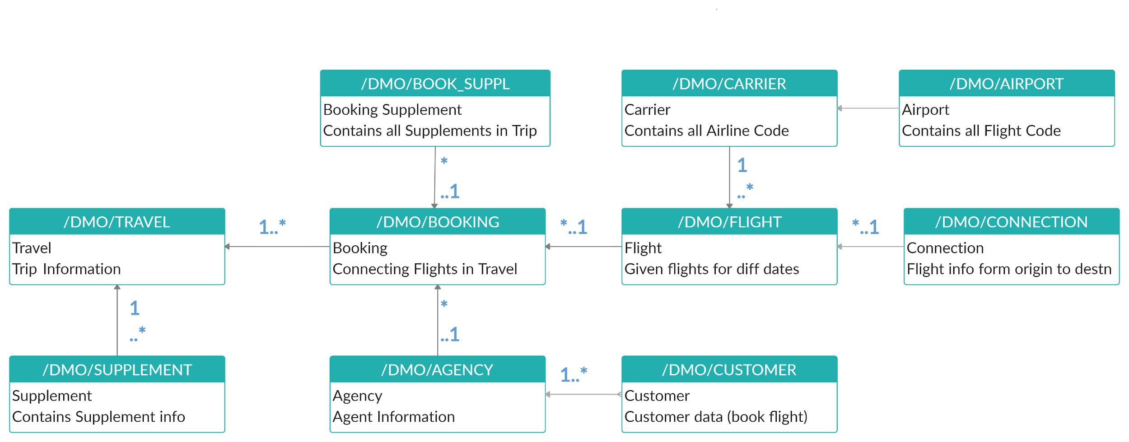
Explanation of Flight Data Model
_M
_M
_M
If Data is not found in these Table’s please execute Data Generator Class “/dmo/cl_flight_data_generator”
www.anubhavtrainings.com

Slide 26
Managed RAP implementation
The managed RAP implementation addresses use cases where all the essential parts of the applications are to be developed from scratch. However, these new applications can highly benefit from out-of-box support for transactional processing. Standard operations like create, update, delete must only be specified in the behavior definition to obtain a ready-to-run business object. The provisioning of transaction buffer is also done automatically for us by the framework. The interaction phase and save sequence are also implemented generically. The application developer can focus on business part of app like adding custom validation, actions, determinations. The RAP transaction engine manages the life cycle of our Business object and covers all the aspects of our app development.
The managed implementation type is aimed for building new applications from scratch without having any prior coding exist. The standard functionality that given in managed business objects is easily retrieved. The business logic implemented using predefined implementation methods that are integrated during the runtime in the interaction phase and save sequence.
www.anubhavtrainings.com

Slide 27



Business use case
We will implementing 2 different applications on travel data model. These applications will target different user groups. We will manage the travel requests and booking through our applications which are booked by agency for customer.
Processor – a processor is an employee of our company who will request a new travel plan through the application. He/she will be allowed to create, update, delete, copy travel requests including bookings and supplements. They have full control to manage their travel.
Approver – an approver is a manager who will only be able to view the travel requests created by employees, and can only change the booking fees and approval status of the request (approve/reject).
MakeMyTrip.com- processor app
Processor needs to create, update, delete a travel request through agency including all bookings and supplements
Approval App
The manager would review the travel requests created by processor, can only change the booking fees and approve or reject the travel request
www.anubhavtrainings.com

Slide 28
Understanding projection
If we ever get requirement in our company to develop a use case where we want to reuse the data model (e.g. sales, purchase, accounting, finance) but develop many applications. We will go with RAP and projections. A projection takes part of the base functionality according the needs to user. This will reduce effort, increase reusability in our app.
www.anubhavtrainings.com

Slide 29
Business Object Definition
From structural point of view, a business object consists of a tree of entities (cds) that are linked in compositions. Every entity in this composition tree is an element that is modeled with CDS view entities. For our demo travel scenario we will implement 3 level composition tree.
/dmo/travel_m
(root entity)
1..N
Business Object
/dmo/booking_m
(child entity)
1..N
/dmo/bookingsuppl_m
(child entity)
www.anubhavtrainings.com

Slide 30
Types of Implementation (Scenario)
Brownfield Implementation
Is used when we want to create a transactional application which can insert, update, delete data from the system by writing your own logic
You already have Business logic with you and you want to use that business logic to perform transactional capability
You are own your own to manage your implementation.
02. Managed Scenario
Greenfield Implementation
Is used when we want to create a transactional application which can insert, update, delete data from the system by using the framework provided implementation
You do not have Business logic with you and you want system to create business logic for you automatically.
01. Un-Managed Scenario
www.anubhavtrainings.com

Slide 31
Managed RAP implementation
The managed RAP implementation addresses use cases where all the essential parts of the applications are to be developed from scratch. However, these new applications can highly benefit from out-of-box support for transactional processing. Standard operations like create, update, delete must only be specified in the behavior definition to obtain a ready-to-run business object. The provisioning of transaction buffer is also done automatically for us by the framework. The interaction phase and save sequence are also implemented generically. The application developer can focus on business part of app like adding custom validation, actions, determinations. The RAP transaction engine manages the life cycle of our Business object and covers all the aspects of our app development.
The managed implementation type is aimed for building new applications from scratch without having any prior coding exist. The standard functionality that given in managed business objects is easily retrieved. The business logic implemented using predefined implementation methods that are integrated during the runtime in the interaction phase and save sequence.
www.anubhavtrainings.com

Slide 32
Business use case
We will implementing 2 different applications on travel data model. These applications will target different user groups. We will manage the travel requests and booking through our applications which are booked by agency for customer.
Processor – a processor is an employee of our company who will request a new travel plan through the application. He/she will be allowed to create, update, delete, copy travel requests including bookings and supplements. They have full control to manage their travel.
Approver – an approver is a manager who will only be able to view the travel requests created by employees, and can only change the booking fees and approval status of the request (approve/reject).
MakeMyTrip.com- processor app
Processor needs to create, update, delete a travel request through agency including all bookings and supplements
Approval App
The manager would review the travel requests created by processor, can only change the booking fees and approve or reject the travel request
www.anubhavtrainings.com

Slide 33
Understanding projection
If we ever get requirement in our company to develop a use case where we want to reuse the data model (e.g. sales, purchase, accounting, finance) but develop many applications. We will go with RAP and projections. A projection takes part of the base functionality according the needs to user. This will reduce effort, increase reusability in our app.
www.anubhavtrainings.com

Slide 34
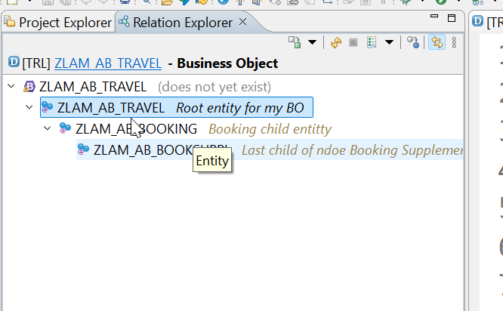


Business Object Definition
From structural point of view, a business object consists of a tree of entities (cds) that are linked in compositions. Every entity in this composition tree is an element that is modeled with CDS view entities. For our demo travel scenario we will implement 3 level composition tree.
/dmo/travel_m
(root entity)
1..N
Business Object
/dmo/booking_m
(child entity)
1..N
/dmo/bookingsuppl_m
(child entity)
www.anubhavtrainings.com

Slide 35



























Slide 36

Development Flow – Processor and Approver
Fiori App – Processor
Create, update, delete, copy travel
Fiori App – Approver
Display the travel request data
Service definition
Service Binding
Service definition
Service Binding
MDE for Processor Projection
MDE for approver Projection
BDEF Projection
For Processor
Expose what is needed by a processor role in company
Behavior Definition (BDEF)
Tell RAP framework regarding our operations which needs to be supported for BO (managed)
BDEF Projection
For Approver
Expose what is needed by a approver role in company
Business Object Projection
For Processor
30 fields to internet
Business Object (definition)
Includes the Travel, Booking and Booking Supplement CDS entities
100 fields
Business Object Projection
For Approver
25 fields
www.anubhavtrainings.com

Slide 37
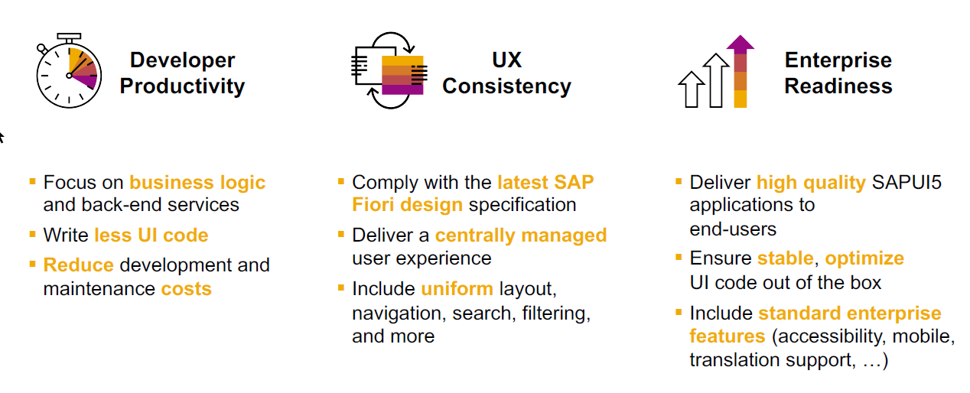
SAP Fiori elements boosts SAP Fiori development efficiency
www.anubhavtrainings.com

Slide 38

SAP Fiori elements prioritizes efficiency over flexibility
www.anubhavtrainings.com

Slide 39


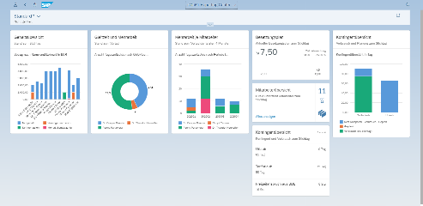





Developer Persona – Fiori Elements
Anubhav
Happy User
Rob
S/4HANA Technical consultant
ABAP Developer
Roxana
UX Designer | Fiori Developer
ABAP Dev. Tools
On
Eclipse
VS Code
BAS
OData Service
Fiori Elements Project
Annotations.xml
CDS Views
MDE
@
www.anubhavtrainings.com

Slide 40
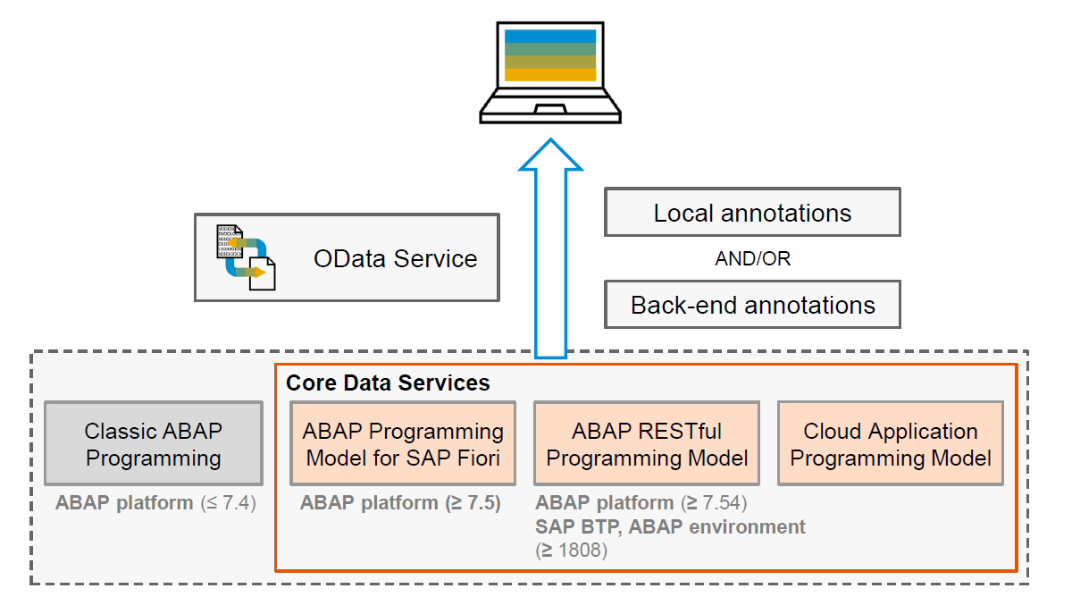
Big Picture – Architecture
www.anubhavtrainings.com

Slide 41
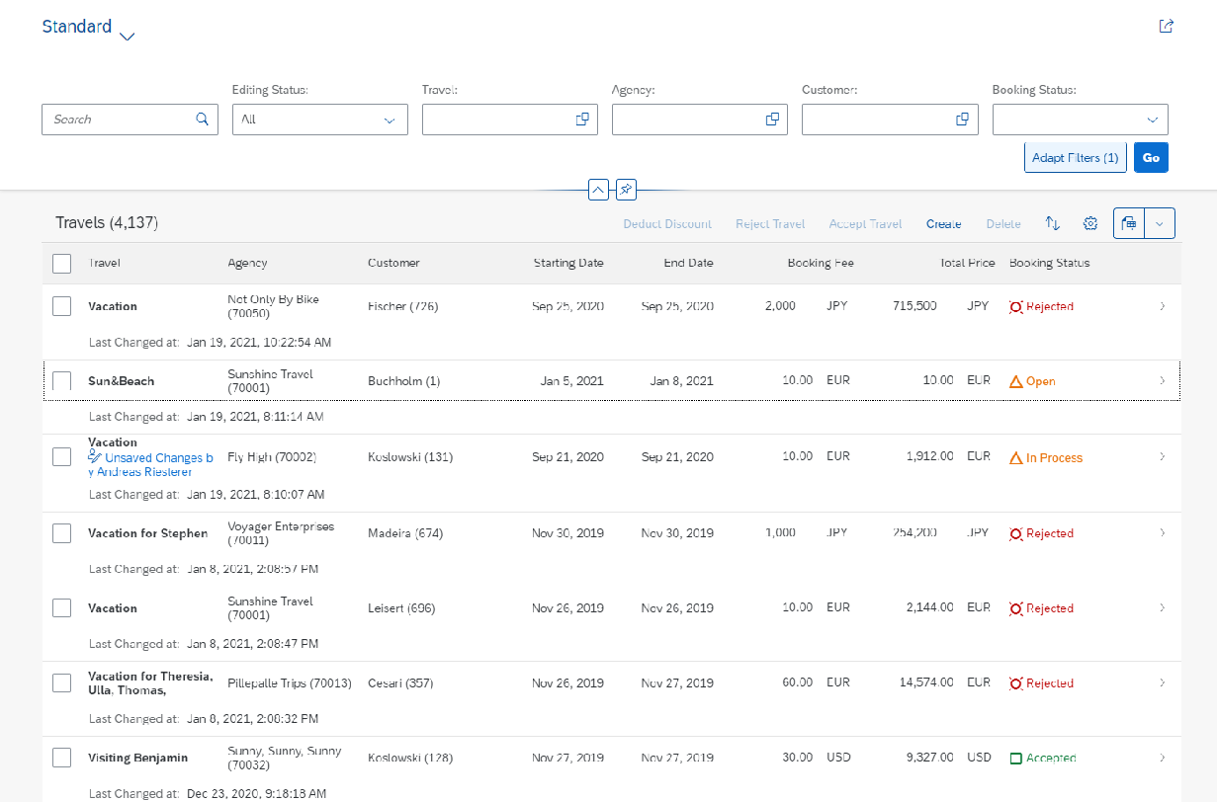
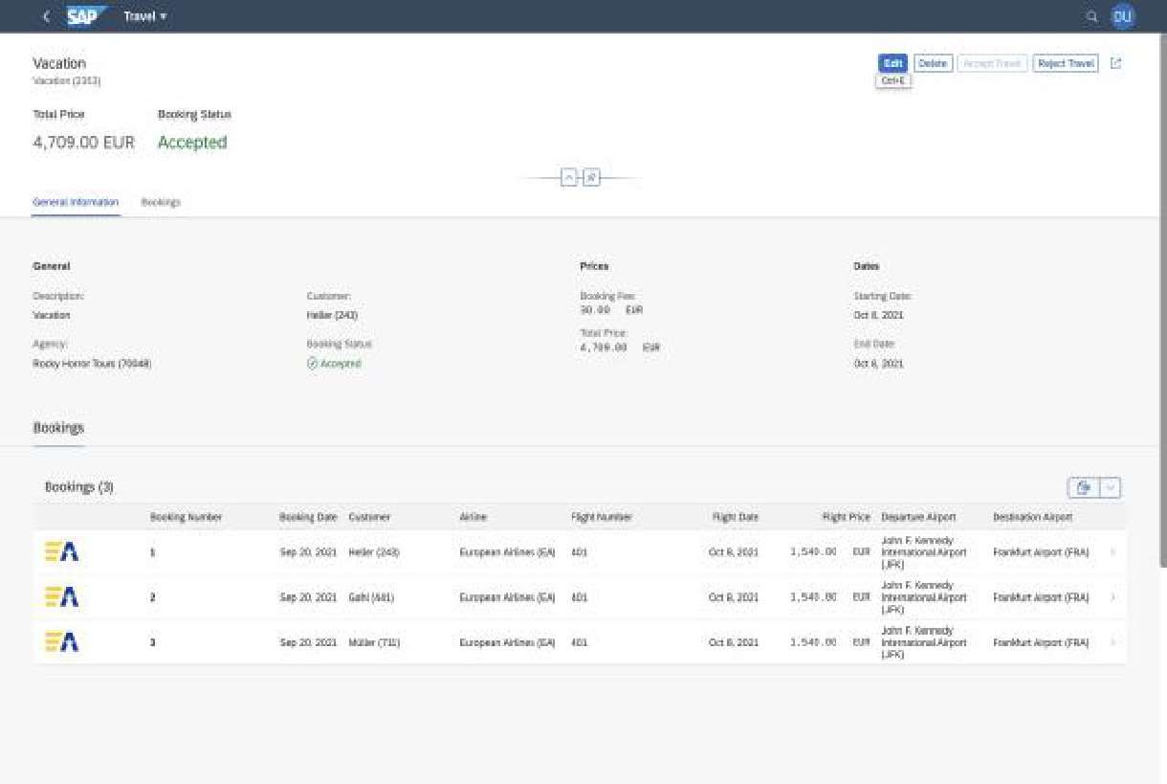
Fiori Elements - List Report Application
The list report offers powerful features for finding and acting on relevant data sets. It is often used as an entry point for navigating to the item details, which are usually shown on an object page.
List Report
Object Page
www.anubhavtrainings.com

Slide 42






Slide 43





























Slide 44
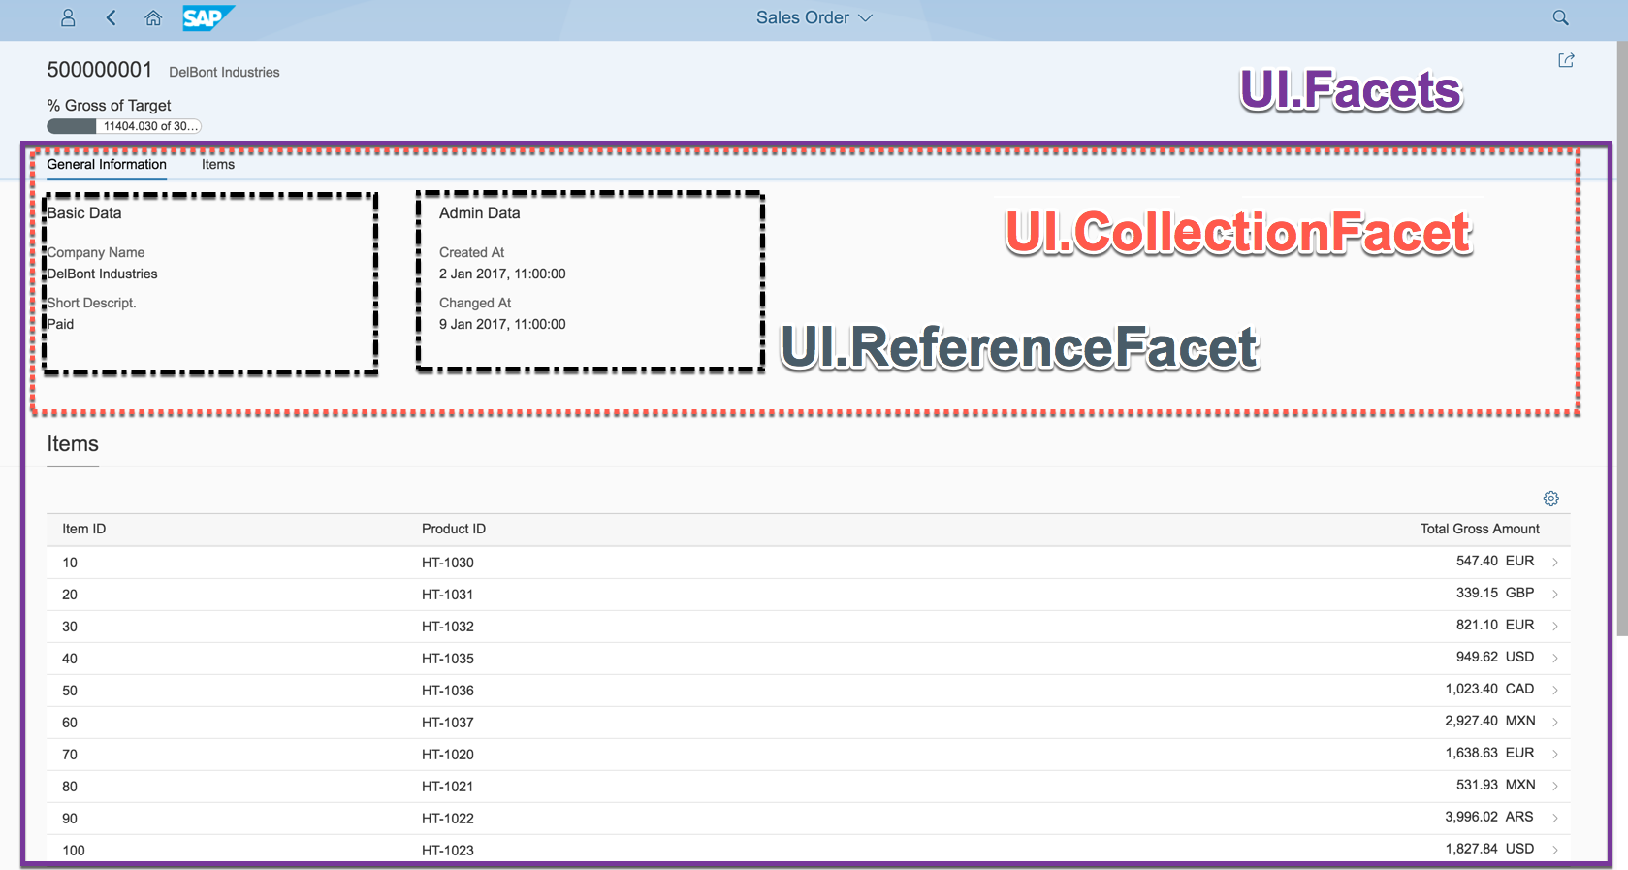
Object Page
www.anubhavtrainings.com

Slide 45
Development Flow – Processor and Approver
Fiori App – Processor
Create, update, delete, copy travel
Fiori App – Approver
Display the travel request data
Service definition
Service Binding
Service definition
Service Binding
MDE for Processor Projection
MDE for approver Projection
BDEF Projection
For Processor
Expose what is needed by a processor role in company
Behavior Definition (BDEF)
Tell RAP framework regarding our operations which needs to be supported for BO (managed)
BDEF Projection
For Approver
Expose what is needed by a approver role in company
Business Object Projection
For Processor
30 fields to internet
Business Object (definition)
Includes the Travel, Booking and Booking Supplement CDS entities
100 fields
Business Object Projection
For Approver
25 fields
www.anubhavtrainings.com

Slide 46
Fiori Elements - List Report Application
The list report offers powerful features for finding and acting on relevant data sets. It is often used as an entry point for navigating to the item details, which are usually shown on an object page.
List Report
Object Page
www.anubhavtrainings.com

Slide 47
Object Page
www.anubhavtrainings.com

Slide 48
Annotation Documentation
https://help.sap.com/doc/saphelp_nw75/7.5.5/en-US/63/0ce9b386b84e80bfade96779fbaeec/content.htm?no_cache=true
https://ui5.sap.com/#/topic/1cf5c7f5b81c4cb3ba98fd14314d4504
@UI.SelectionField – Create filter fields on screen 1 (List Report)
@UI.LineItem – Create Columns on first Screen (Table area on list report)
@UI.HeaderInfo – Provide title to the table and arrange header for the object page (second screen)
@UI.Facets – To create tabs on the object page
@UI.Identification – can only be one, Configure default fields on object page (inside facet)
@UI.FieldGroup – To create field groups (group of fields) in a block with label and text
@UI.datapoint – to create a single value to be displayed in a chart or on top of page
@UI.Chart – to create a chart with a particular chart type
www.anubhavtrainings.com

Slide 49
Behavior Definition (BDEF)
Behavior definition describes the behavior of the business object in terms of what operations are allowed for our entire BO. If the BO consists of multiple entities (e.g. Travel, Booking, Booking Suppl), there is exactly one BDEF which exist for this business object.
The BDEF will have exactly same name as your root entity, you are not allowed to change the name. We can test our business object once the behavior definition is created. The RAP framework will auto generate all the necessary code behind the scenes to handle the CURD (Create, Update, Read, and Delete) operations on our BO.
Based on the BDEF, the RAP framework will decide whether it’s a managed or unmanaged scenario. In addition to CURD, we can also maintain the actions, determinations, prechecks, validations, draft availability, draft actions etc. as part of behaviour definition.
The name of BDEF is always same name as your BO.
https://help.sap.com/docs/ABAP_PLATFORM_NEW/fc4c71aa50014fd1b43721701471913d/761d389302e8463a9c3509907f22f22f.html?q=behavior%20definition#loio761d389302e8463a9c3509907f22f22f__impl_strict_transAct
Business Object
Travel(root)+Booking+Booking Suppl
Behaviour Definition
1 0..1
www.anubhavtrainings.com

Slide 50
Framework Generated IDs
The RAP framework will contain multiple framework generated values when data comes to us in our ABAP code or when we process the BO instance. All the framework generated parameters starts with %
%CID
During create mode the primary key of BO instance is not generated, until the save sequence is execute (like late numbering) like in our case the travel id is created after all the validations are passed. We have %CID also known as content id and is used in the OData request to bind the result operation to a name so that it can be referenced in another operation later. I sent a call from my laptop, one of the browser session, so if there is a issue, I only should get the error on my screen.
It is like a temporary primary key which is given by the RAP framework kept in the transaction buffer to track the user session or our BO instance. Later on once the actual key is generated, the %CID will act like a foreign key to associate with session and will sent back to RAP by us to inform RAP that which session does this operation belongs to.
%tkey
When we apply operations on our table like a action. We also receive a table key in our code, and based on that we will reply the RAP that a particular operation on the table was completed. If something goes wrong we will also inform the error to the RAP framework using this table key.
%key
For a single operation like Edit, Delete inside the object page, we will also receive the key of the object which we are editing or deleting.
www.anubhavtrainings.com

Slide 51
EML – Entity Manipulation Language
The EML is part of ABAP language that access to RAP BO. Because the consumption of business object via odata protocol requires a Fiori UI or Web API, the EML enables a type-safe access to business object directly. EML interacts with the business object entities (single entity – travel) to perform all the entity operations.
EML can be used to provide behaviour for business object. For example, we can implement an action that first triggers a create and then a update using the EML. It is one of the best way to consume our RAP framework and Business object using plain ABAP code w/o creating any special API or service.
Use cases:
Consumption of RAP functionality in Plain ABAP
Testing purpose
Build special business logic
Generate test data
For integration with classic code
www.anubhavtrainings.com

Slide 52
Syntax for EML
Read operation
Read from Root entity and by the key
Read the root entity with its composition child (travel and booking together)
A read operation always either returns a RESULT 🡺 capture in a internal table
OR returns an error table called as FAILED 🡺 capture in a internal table
AND returns an table of messages as REPORTED 🡺 capture in a internal table (other messages)
If we use second option we can specify the associated entity using \_AssociationName
READ ENTITIES OF RootEntityName
ENTITY EntityAlias FROM keys ---(primary key value)
RESULT lt_result
BY \_Composition FROM child_keys
RESULT lt_result_child
FAILED lt_failed
REPORTED lt_reported.
www.anubhavtrainings.com

Slide 53
Update and Delete operations
MODIFY ENTITY OF EntityName AS alias_name
ENTITY EntityName
CREATE FROM lt_create
UPDATE FROM lt_update
DELETE FROM lt_delete
CREATE BY \_AssociationName FROM lt_instance_cba
RESULT lt_result
FAILED lt_failed
REPORTED lt_messages
MAPPED lt_mapped.
www.anubhavtrainings.com

Slide 54
www.anubhavtrainings.com
Thank You
End of Day 6
www.anubhavtrainings.com

Slide 55


We’re committed to empower you to be
#FutureReady
through powerful training solutions.
We build the workforce of the future.
250+
Corporate Clients
30,000+
Learners Trained
25000+
Learners Placed
FREE WEBINARS
Sign up for free webinars with industry experts every fortnight!
Enroll Now!
Contact us today!
https://anubhavtrainings.com

